Slide 1

Week 3 Sessions 1 & 2
9/10/2025
9/12/2025

Slide 2
Ch1. Overview of topics:
Class
Object
Abstraction / Encapsulation
Constructor
Constructor Overloading
Method
Method Overloading
Mutators / Accessors
Access Modifiers
‘this’ keyword
References
Static
Array List
Packages

Slide 3
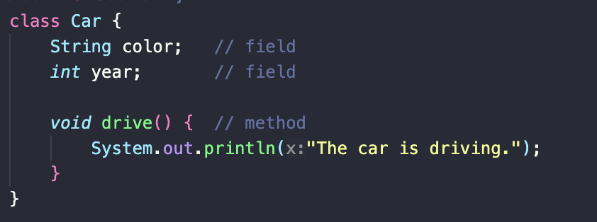
Class
A class is like a blueprint. An architect’s plan for building a house. It describes what the house would have (rooms, doors) and what it can do (open door, turn on lights). But it’s not a house yet.

Slide 4
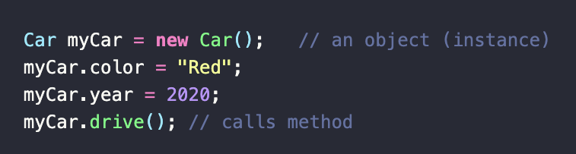
Object
An object is like the real house that is built from the blueprint. You can walk inside, paint it, live in it. Each object has its own unique values.

Slide 5
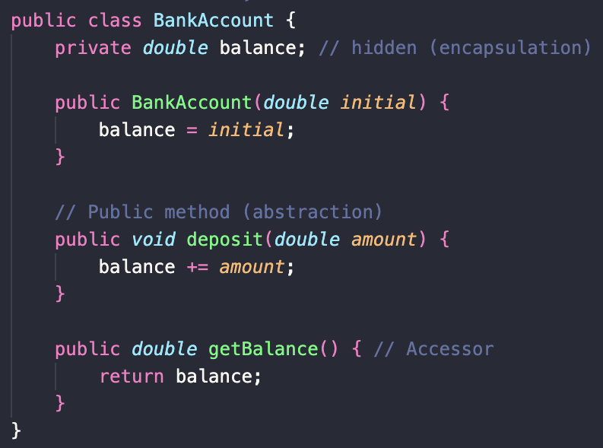
Abstraction & Encapsulation
While driving a car, you just use the steering wheel, pedals, and the gear shifter, but you don’t need to know the engine details.

Slide 6
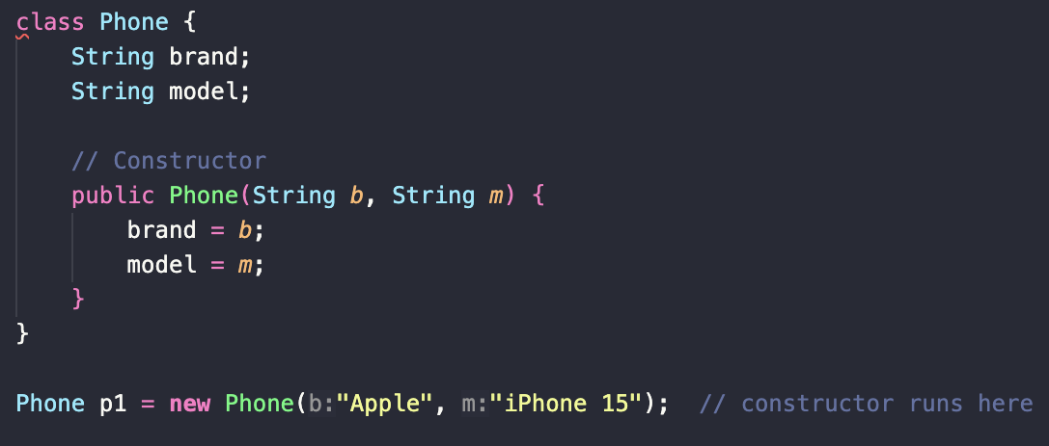
Constructor
The constructor is a special method:
It has the same name as the class.
It has no return type
Runs automatically when an object is created with the ‘new’ keyword.

Slide 7
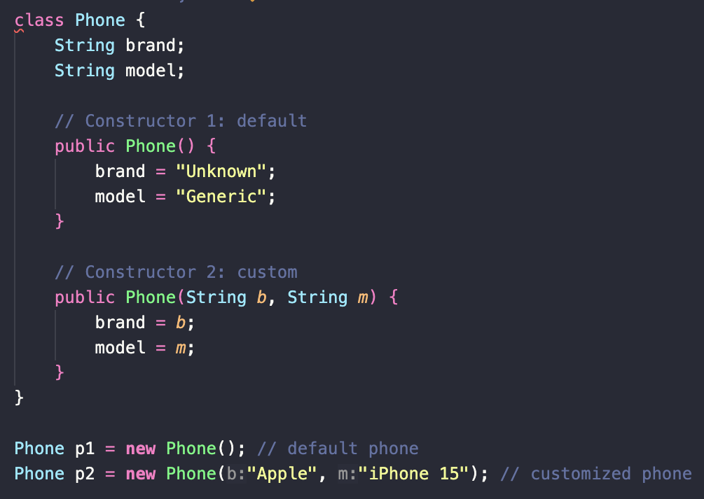
Constructor overloading
When you buy that phone, you can either:
Take the default version (“just give me whatever is in stock”).
Customize it (“I want the iPhone 15 in blue with 256 GB”).

Slide 8
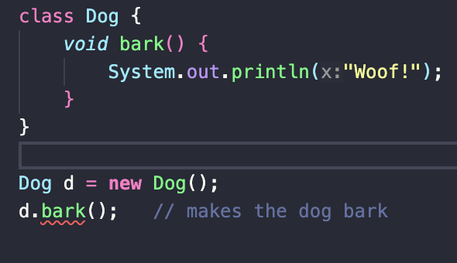
Method
An action your object can perform. Like ”drive” for a car, or ”bark” for a dog.

Slide 9
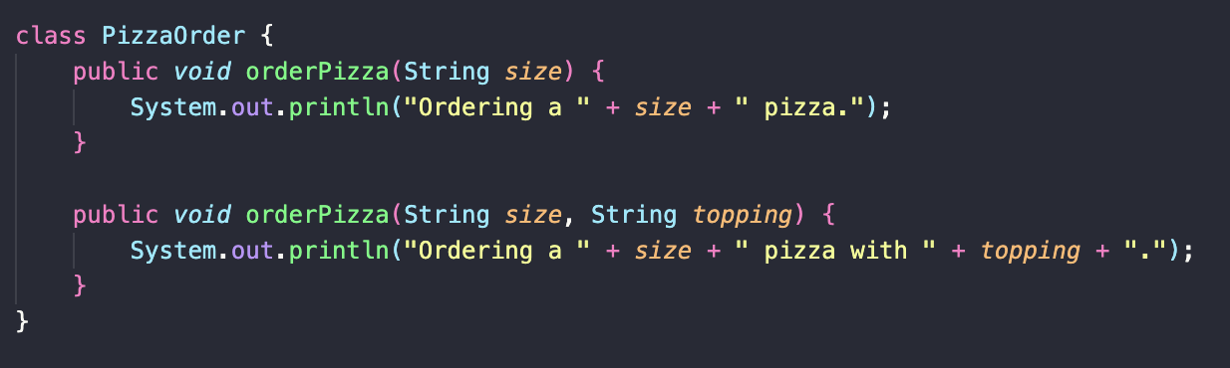
Method overloading
Same action as methods, but different details.
It’s like calling a pizza place. Sometimes you just say the size, other times you say size + topping.

Slide 10
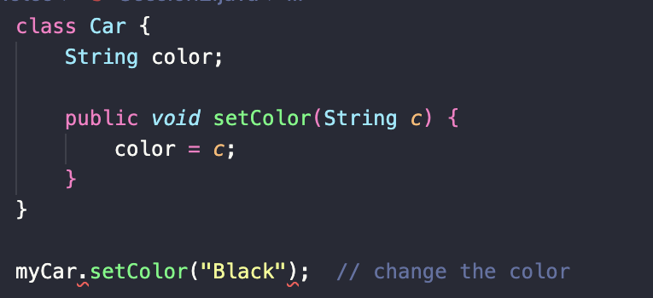
Mutators (setters)
A setter is like a remote control. You can use it to change something inside the object, like turning the volume up on a TV. Or setting a color to be black on a car.

Slide 11
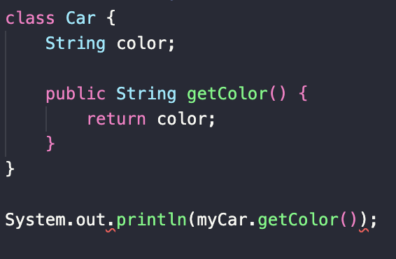
Accessors (Getters)
Getters are like the dashboard. They let you read information without changing it. Like checking your car’s speedometer. Or Checking what color your car is.

Slide 12
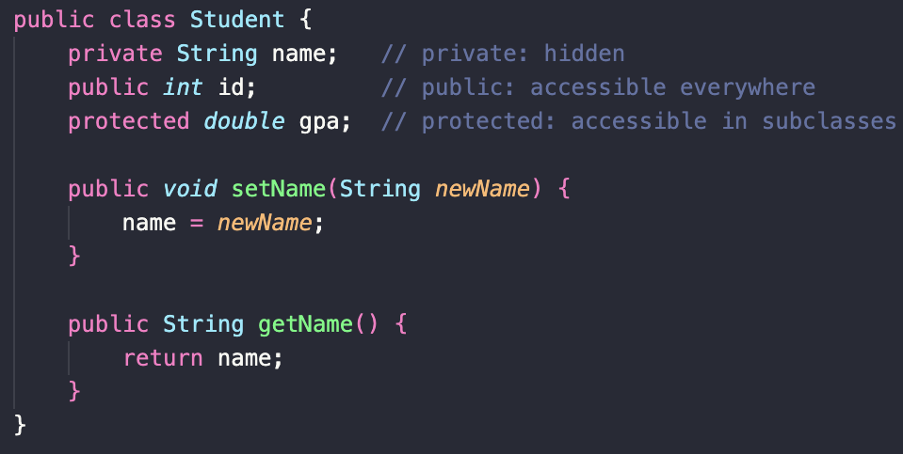
Access Modifiers
Public ➡️ visible everywhere
Private ➡️ visible only inside the class
Protected ➡️ visible in subclasses and package
Default (no keyword) ➡️ visible only in same package

Slide 13
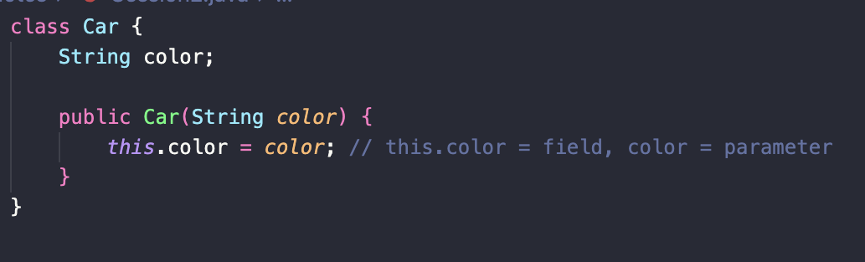
The ‘this’ Keyword
It’s like saying “I am Joe”/”I myself”. It points to the current object’s own fields.

Slide 14
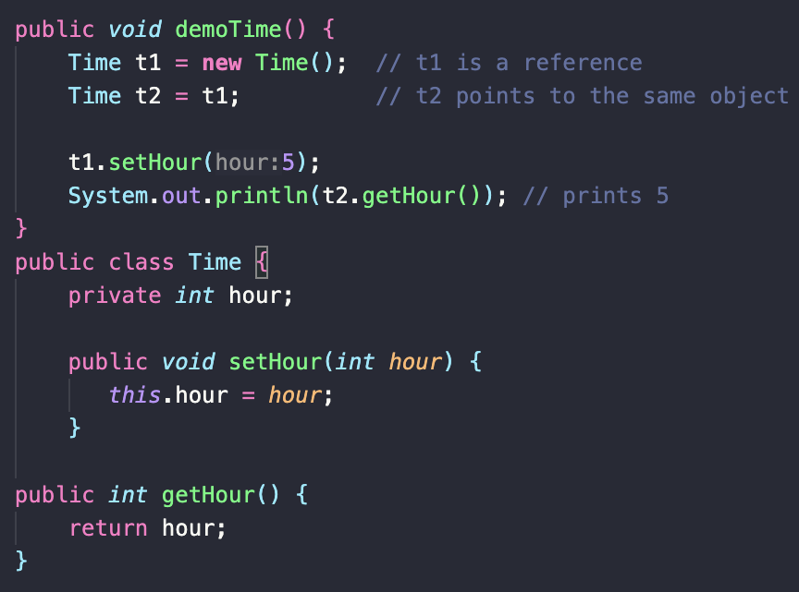
Reference
When you create objects with the ‘new’ keyword, you’re working with references.
A reference stores the address of an object in memory

Slide 15
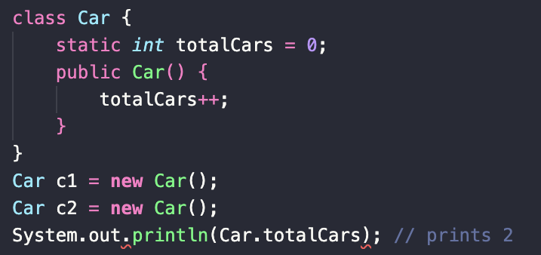
Static (Fields & Methods)
A shared bulletin board in the dorm buildings. Everyone in the building (all objects of the class) can see and update it. Or increasing the number of cars needed for a Car company you work at.

Slide 16
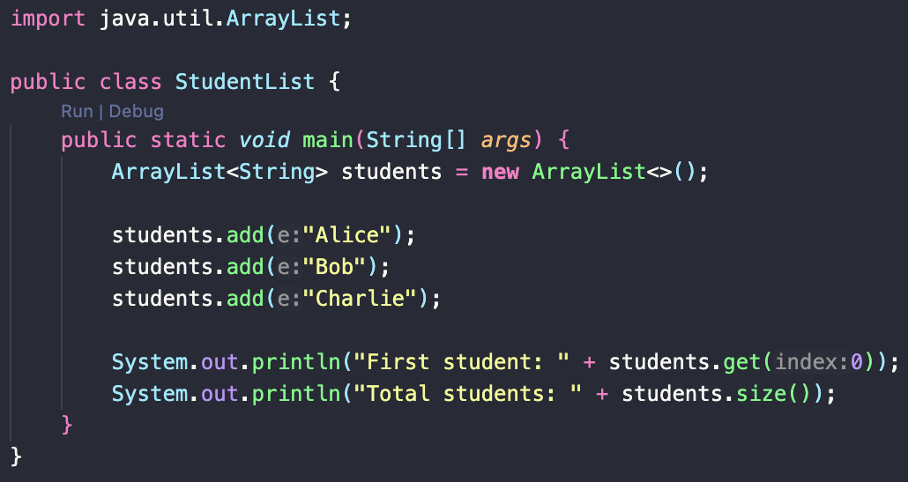
Array Lists
An Array List is the first real data structure, it connects objects + references + memory.
An array list is a resizable array that stores object references.

Slide 17
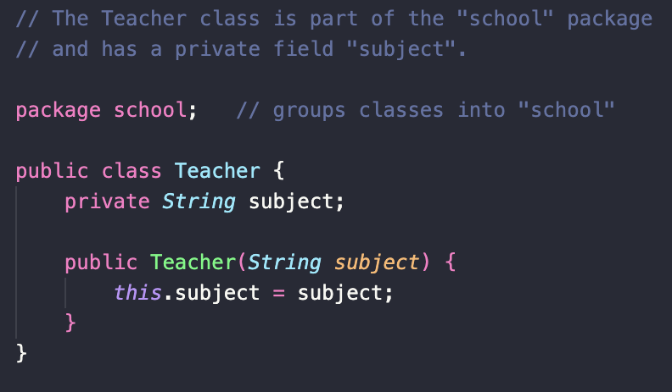
Packages
Packages are about organizing many classes/structures so they flow well after showing multiple objects in an Array List.
They are a way to organize classes into folders.
Example: java.util.* contains Array List, Scanner, etc.

Slide 18
Week 4 Sessions 3 & 4
9/17/2025
9/19/2025

Slide 19
Chapter 2 Inheritance
Basics & Analogy
Types of Inheritance
Access Specifiers in Inheritance
Method Overriding
Polymorphism
‘super’ keyword

Slide 20
Inheritance
The idea behind inheritance:
One class can inherit fields + methods from another class.
Think of it as a family tree: Children automatically get traits from parents, but can also add their own

Slide 21
Inheritance analogy
Parent class (superclass): Animal -> all animals eat and sleep
Child class (subclass): Dog -> dogs eat, sleep, and bark.

Slide 22
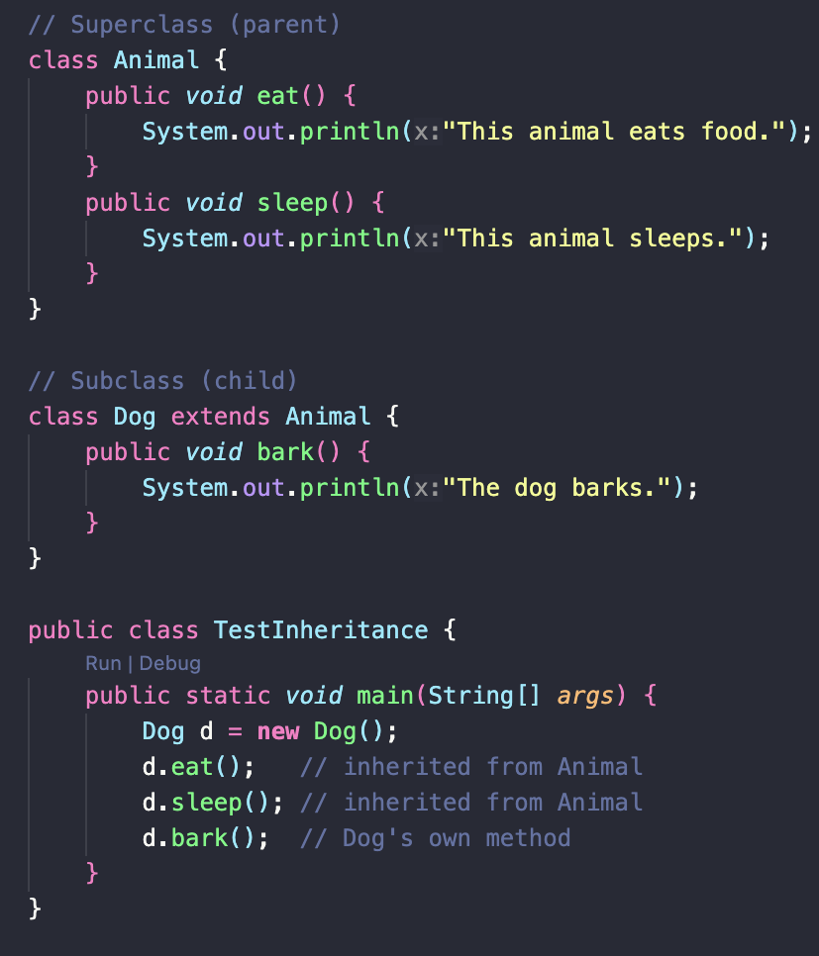
Inheritance code
Output:
This animal eats food.
This animal sleeps.
The dog barks.

Slide 23
Types of Inheritances:
Single inheritance
Multilevel inheritance
Hierarchical inheritance.

Slide 24
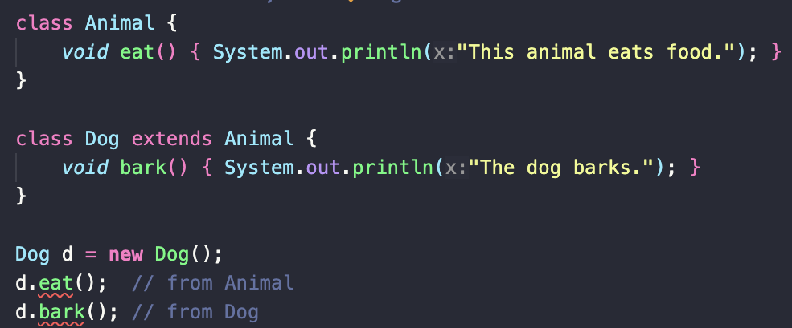
Single inheritance
One child inherits from one parent.
Analogy: You inherit traits from your mom.
Another analogy is Dogs inherit traits from the class Animal.

Slide 25
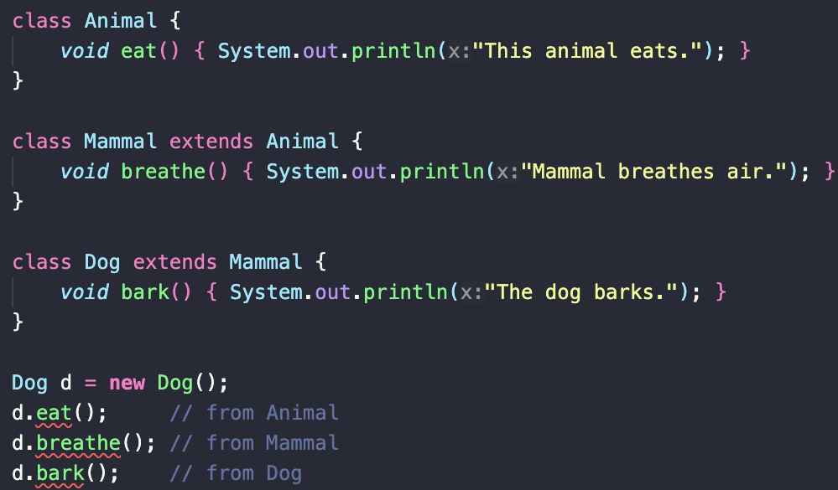
Multilevel Inheritance
A class inherits from a child class, forming a chain.
Analogy: Traits pass from grandparent -> parent -> child.

Slide 26
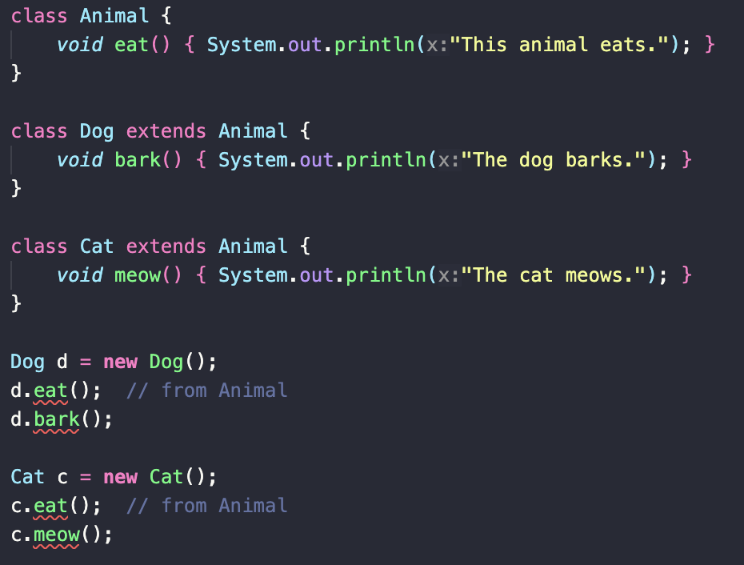
Hierarchical Inheritance
Multiple classes inherit from the same parent.
Analogy: Siblings inherit traits from the same parent.

Slide 27
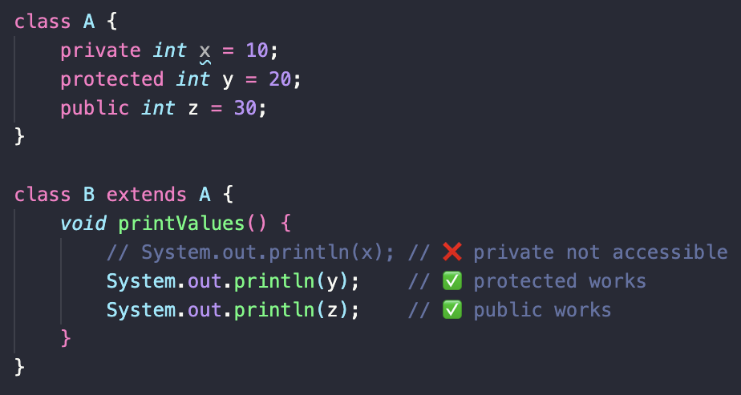
Access Specifiers in Inheritance
Public ➡️ Everyone knows
Protected ➡️ only your family & close relatives know.
Private ➡️ only you know

Slide 28
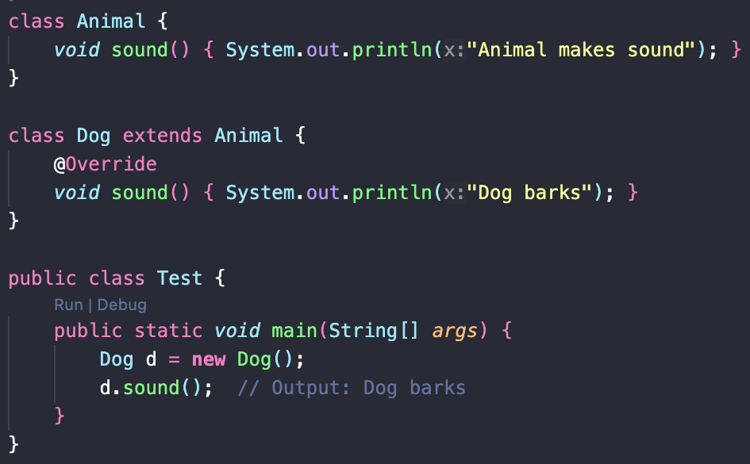
Method Overriding
The subclass redefines a method from superclass
Same name + same parameters.
Lets subclass provide its own version.
Ex: The parent cooks spaghetti plain.
The child cooks spaghetti with spices

Slide 29
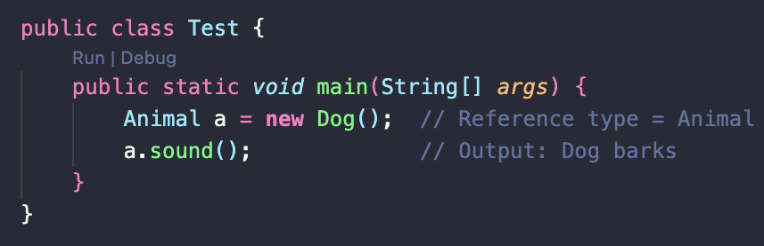
Polymorphism (multiple forms)
Polymorphism means “many forms”. Code wise, it means one interface, different behaviors.
Compile time polymorphism -> Method Overloading
Runtime Polymorphism -> Method Overriding
The same word “run” -> run a race, run a business, run a program.

Slide 30
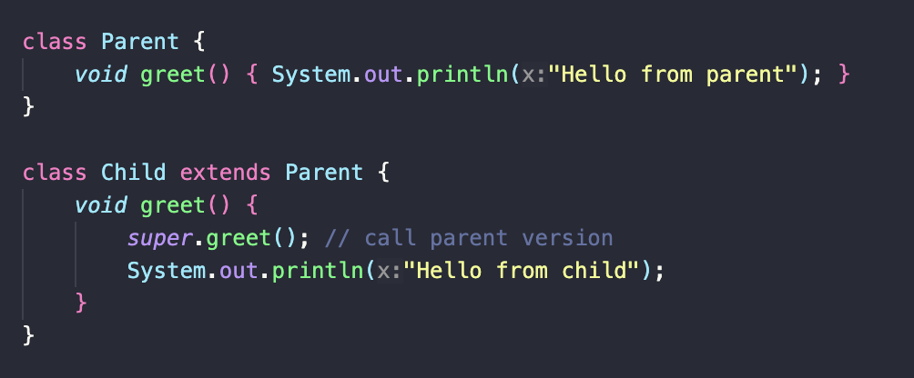
The ‘super’ keyword
Outputs: Hello from parent.
Hello from child.
Calls parent class constructor/method
Lets child class use parent’s version before adding its own.
Example: A child says, “Let my parent talk first, then I’ll add my part”.

Slide 31
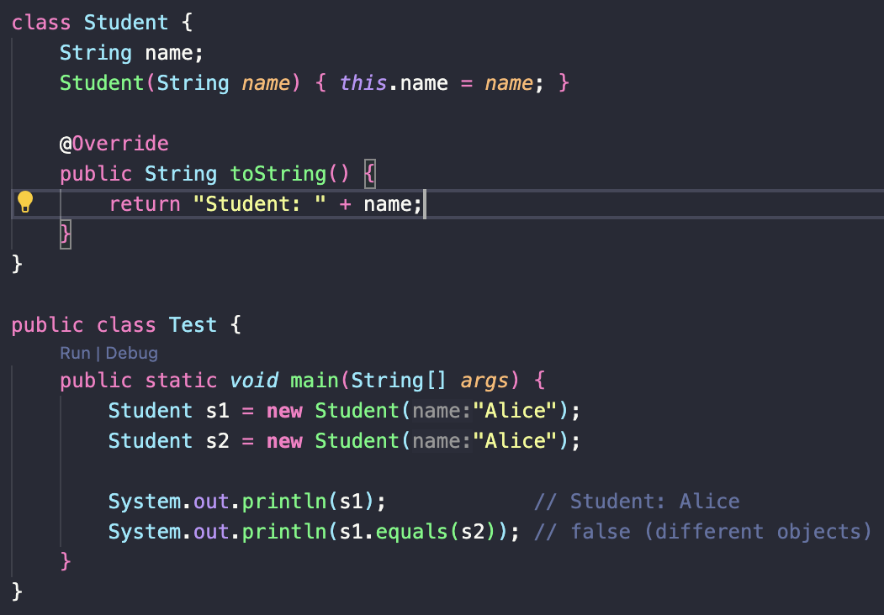
Object Class
Every class in Java extends Object automatically
Common methods:
toString() -> text description
Equals() -> compares objects.
You don’t need to import it, it comes as is in Java.

Slide 32
Week 5 Sessions 5 & 6
9/24/2025
9/26/2025

Slide 33
Chapter 3 – Abstract Classes
Abstract classes
Abstract Methods
Interfaces

Slide 34
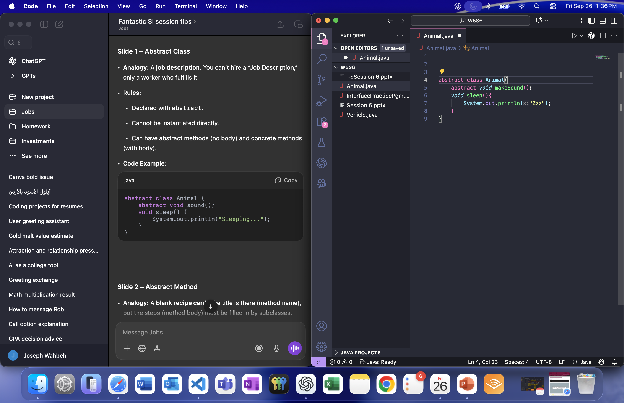
Abstract class
Analogy: A job description. You can’t hire a “Job description,” only a worker who fulfills it.
Rules:
- Declared with abstract.
- Cannot be instantiated directly.
- Can have abstract methods (no body) and concrete methods (with body).

Slide 35
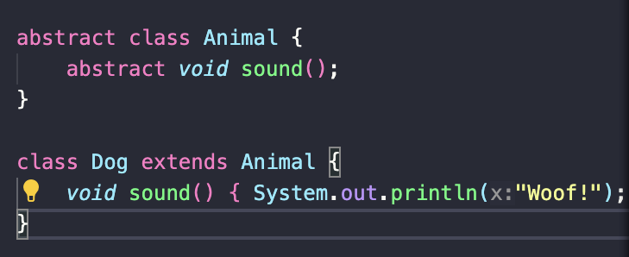
Abstract Method
An example is a blank recipe card. The title is there (Method name), but the steps (Method body) must be filled in by subclasses
Rules:
-Declared with abstract keyword
- No body { }.
- Subclass must provide implementation.

Slide 36
Concrete vs Abstract
Concrete class: Can be instantiated. All methods have bodies.
Abstract class: Cannot be instantiated. May contain abstract methods.
A way to remember this is:
Abstract = “template only.”
Concrete = “finished product.”

Slide 37
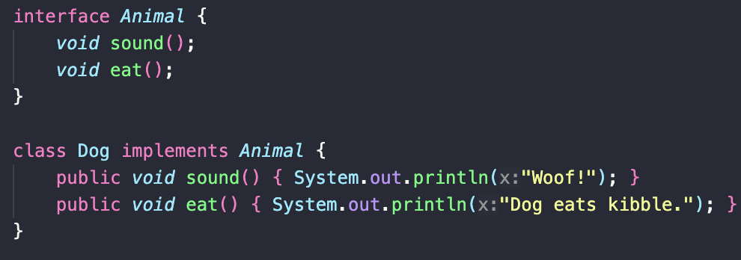
Interfaces
An interface is like a contract. It lists what must be done, but not how.
Rules:
Declared with interface
All methods are abstract (Java 7), or can be default/static (Java 8+)
A class can implement multiple interfaces.

Slide 38
Abstract vs. Interface
Abstract class:
Can have fields + concrete methods
Single inheritance
Interface
No instance fields (constants only)
Multiple inheritance (class can implement many).
A way to remember this:
Abstract class
Job description + Shared instructions.
Interface
Pure contract (no details).

Slide 39
Exit ticket
Why can’t you create an object of an abstract class?
What must a subclass do if its parent has abstract methods?
What’s one big difference between an abstract class and an interface?

Slide 40
Exit ticket Answers
Because an abstract class may have abstract methods (incomplete methods). You can’t instantiate something that isn’t fully defined.
The subclass must override and provide implementations for all abstract methods. Unless the subclass is also declared abstract.
Abstract & Interface:
Abstract Classes: Can have fields and both abstract + concrete methods, and you can only extend one class.
Interface: Only declares methods (no instance fields), but a class can implement multiple interfaces

